Slide 1
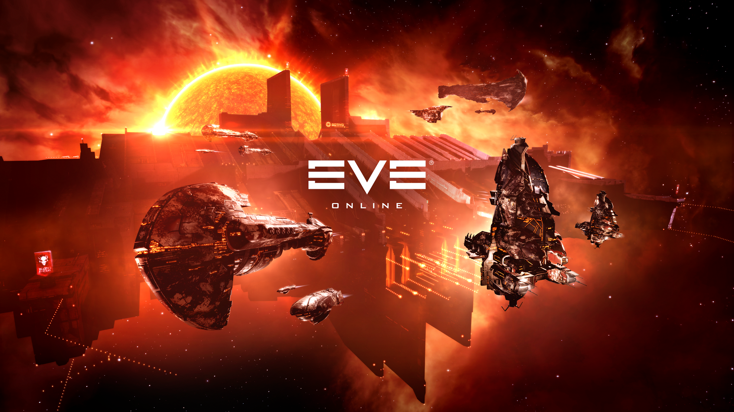
Anger
MIS 699 Team 2:
Yue Xu
Mohit Mhapuskar
Pratik Patel
Mukunth Rajendran
Story Pitch
Notes:
Find a pattern of our analysis
Reason why gameplay is here
Use chart shows the business implications

Slide 2
Team Coordination Strategy
Pratik Patel: Project manager, Coordination
Mukunth Rajendran: Data scientist, Data Visualiser
Mohit Mhapuskar: Data Analyst, Event Researcher
Yue Xu: Data Analyst, Event Researcher
Notes:
Yue
Correlation coeffibetween anger and other variables？
Project manager
Data scientist
Data analyst
business analyst

Slide 3
Introduction
Anger: It is an intense emotional response that involves a strong uncomfortable and hostile response to a perceived provocation, hurt or threat.
Anger could be either positive or negative. Generally, positive anger is generated from competing; negative anger might be unsatisfaction for unexpected changes.
Why is studying “Anger” important?
Eve Online has a massive and dedicated audience that is very focused on any changes that CCP makes. By studying and predicting what causes, Anger, CCP can ensure they are making the right decisions for their audience.
Notes:
Yue
T20 corruption: 2007-2008
Formation of CSM: 2008
Incarna crisis: 2011
Modified voting system: 2012-2014
NDA leaks: 2015

Slide 4
Mission
Understand the root cause of Anger in the Eve Online Community.
Find out what variables can be manipulated to reduce anger in Eve Online Community.
Use this understanding to create a future strategy for CCP that is more aligned with the interests of the community.
Notes:
Yue

Slide 5
Overview
Hypothesis for core mechanism & content mechanism which could cause anger
Analysis for some detailed expansion related to mechanism
Analysis for gameplay
Analysis for anger - reward & progression system relationship
Suggestions
Notes:
Add reward scale which might show a really interesting influence on anger

Slide 6
Hypothesis - What’s causing anger?
All gameplay mechanics can be categorized into two broad types: Core Mechanics & Content Mechanics.
Core Mechanics form the very basic foundation of the game that allows the players to interact with the various content mechanics present in the game. For example, Combat mechanics, Spaceship physics, Inventory menus, Trading menus, Cockpit UI etc.
Content Mechanics are the collections of various systems that provide the actual gameplay/entertainment to the player. For example, Missions, Battlecraft, Planets to explore, cosmetic items, weapons.

Slide 7
Hypothesis - Core & Content Changes
The Expansions/updates that implement overhauls/radical changes to core gameplay mechanics seem to be the ones that cause the most anger in the player community.
Updates that include minor upgrades/refinements to core mechanics and focus more on adding gameplay content such as missions or quests are received more favorably by the playerbase.
However, if the radical changes implemented to core mechanics are based on adequate received feedback, then those changes cause considerably less anger among players.

Slide 8
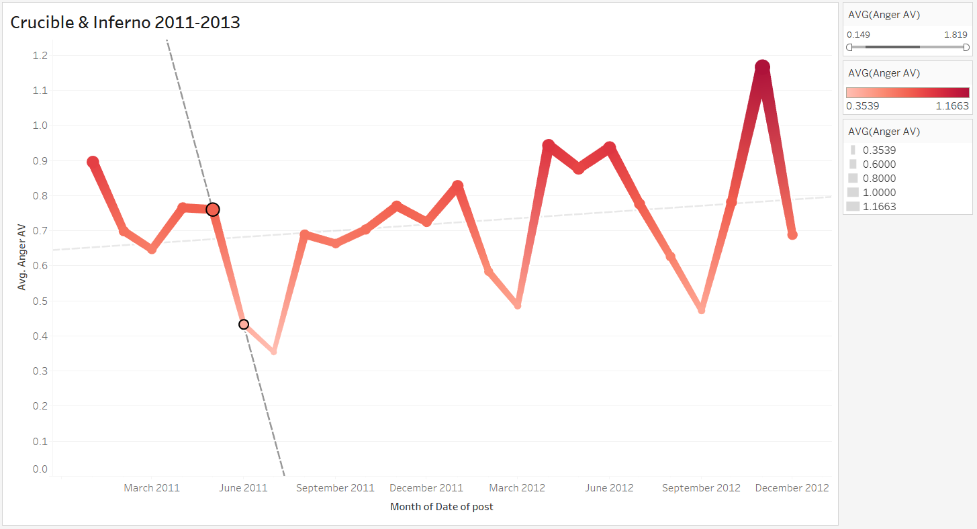
Crucible Expansion - Changes to Content Mechanics
The Crucible expansion introduced new battlecruisers, battleship weapons, new cockpit quarters along with some visual changes and refinements to UI.
As this expansion only introduced minor changes to core mechanics(UI changes) and added more meaningful content mechanics, the update was received favorably and resulted in an overall decrease in anger.
Crucible Release
Crucible release

Slide 9
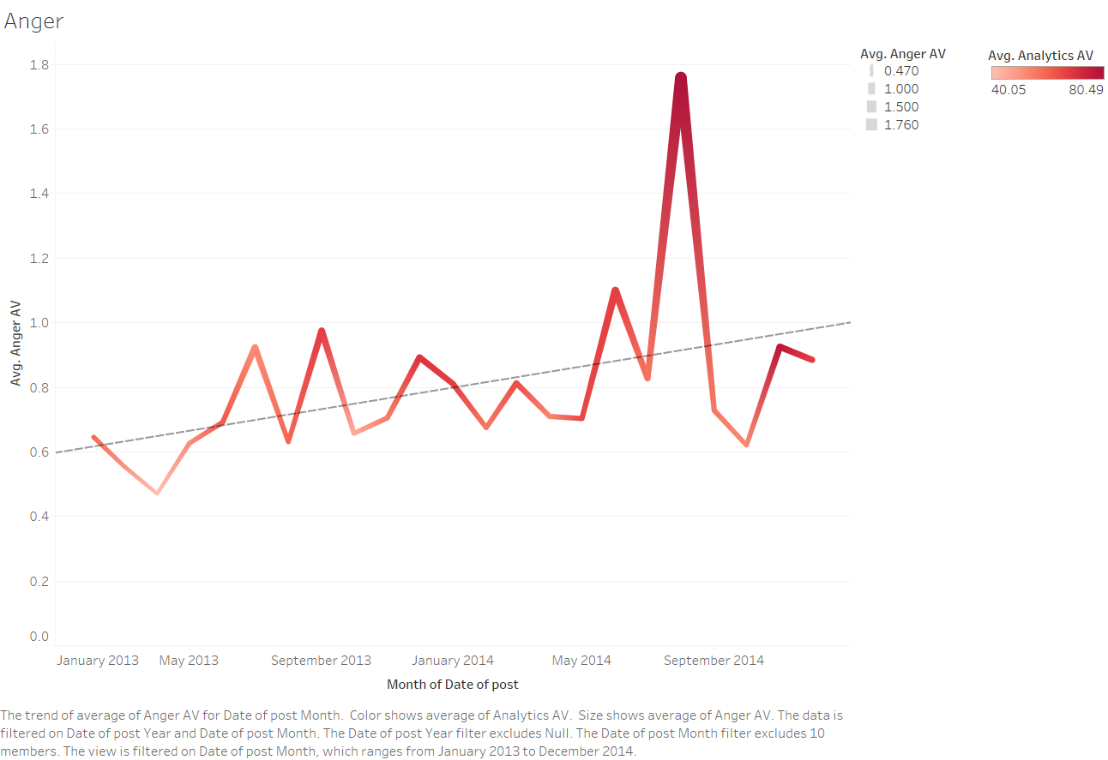
Kronos Expansion - Changes to Content Mechanics
Similar to the crucible expansion, the kronos expansion also focuses on adding content mechanics to the game also in the form of new ships, purchasable cargo holds and new cosmetic items.
As a result, there was a downward trend in anger as players received the new content favorably.
Kronos Release

Slide 10
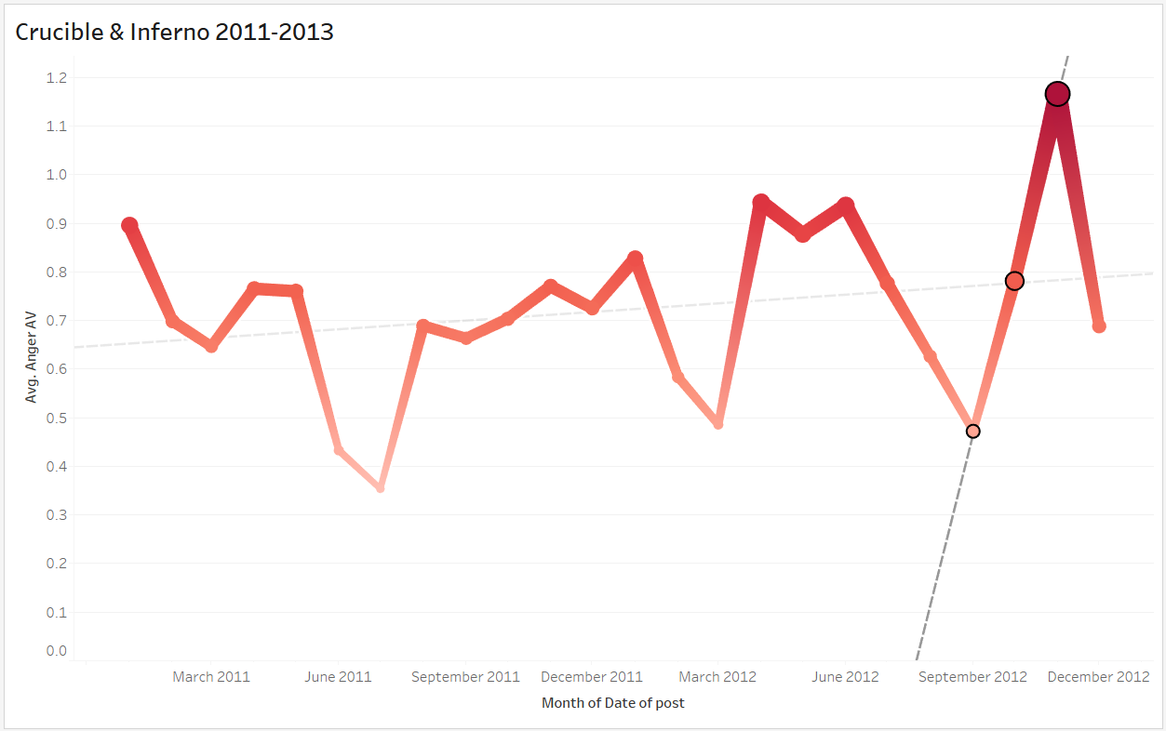
Inferno Expansion - Changes to Core Mechanics
The Inferno expansion brought massive overhauls to the war declaration system and the inventory management system, along with some graphical updates.
Since this expansion introduced radical changes to two major core mechanics of war and inventory management, it’s release caused a backlash in the player community, producing a huge spike in anger.
Inferno Release

Slide 12
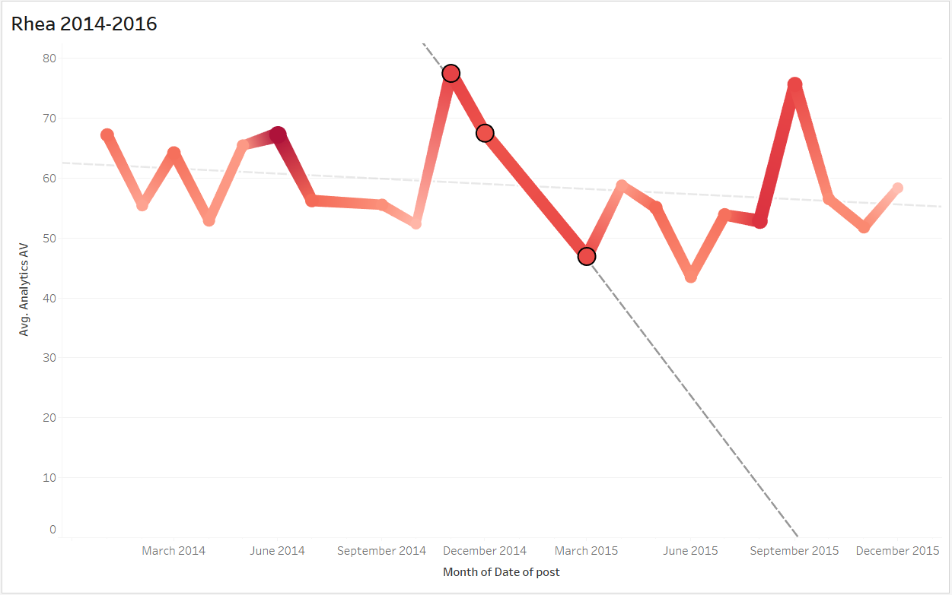
Rhea Update - Requested Changes to Core Mechanics
The Rhea update completely overhauled deaths in the game with no skill points lost upon death. As a result this was this was one of the most radical changes to a critical core gameplay mechanic in EVE.
In this case however, this change to the death system was a feature widely requested by the player community, with enough feedback received prompting CCP to implement it. Thus, the overall reception to this release was positive, resulting in a decrease in anger.
Rhea Release

Slide 13
The Solution?

Slide 14
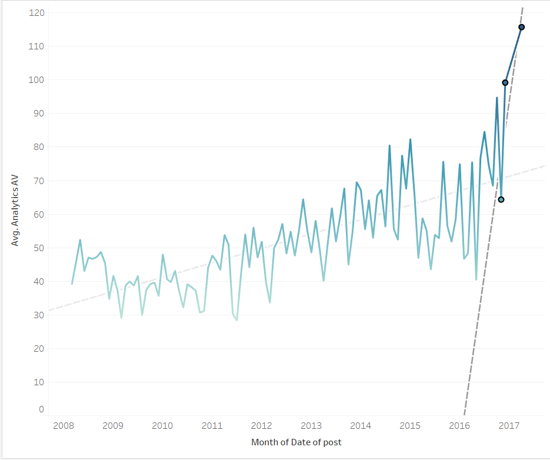
Project Discovery - (Real science in a game)
A mini game that was launched in Eve Online in 2016.
The players were asked to search for planets outside our solar system, Focussed on discovering real planets (Exoplanets).
This expansion also brought some changes to the bounty, skill points and established hacking mechanics, all of which are core mechanics.
Under other circumstances, these changes to core mechanics would have resulted in considerable anger amongst players.
However, because of the implementation of its unique reward system, there was little to no anger amongst players. An anomaly.
Players receive in-game currency for each observation they make and may also earn special credits.
There were analytics used to bring out this game and it took several years to predict what would be the appropriate growth potential. Moreover there were rewards given to the players, which in-turn reduced the anger among the players (In-game rewards and currency).
Start of Project Discovery

Slide 15
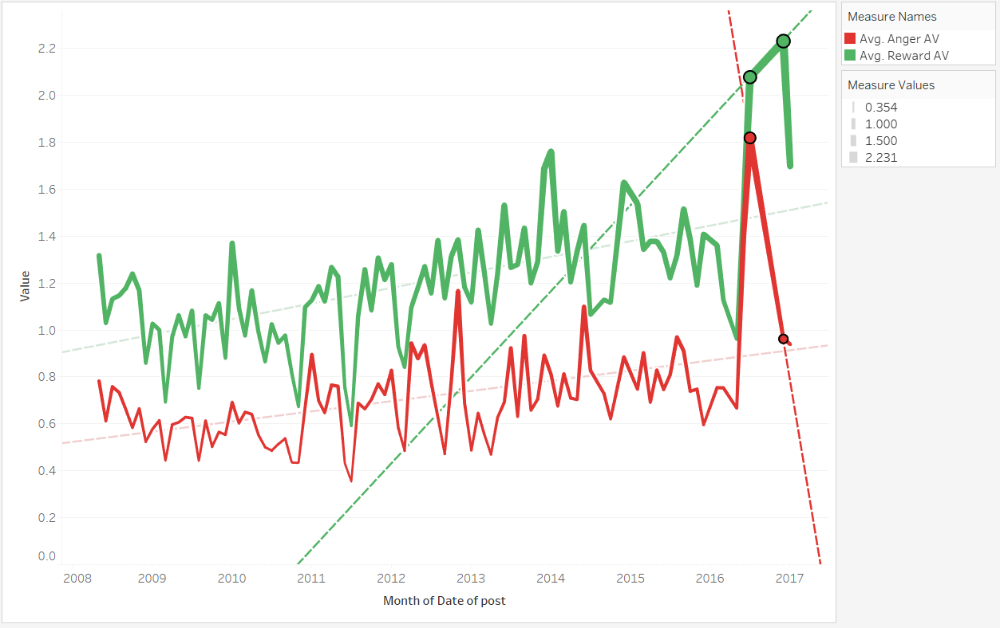
Anger-Reward Relationship
Start of Project Discovery
Anger and Reward have an inverse relationship with Anger falling drastically when Reward is at its peak.(A Perfect 10 on our Reward Scale).
Project Discovery managed to fulfill every criteria, resulting in a reward peak never observed before.
CCP can mitigate controversial decisions such as changes to Core Mechanics by implementing more challenges that give players a sense of reward and a progressive gameplay.

Slide 16
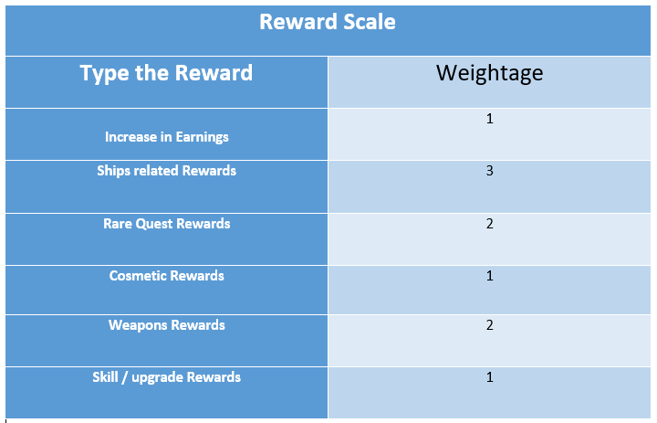
Reward Scale for Expansions:
A way to quantify the level of reward each expansion offers on a 10 point scale.
The weightage values have been assigned from analyzing the various forum posts to see what type of rewards users prefer from expansions.
Higher the reward level of a core expansion, lesser is the general increase in anger.
If an expansion scores a perfect 10 on the scale, we have observed a considerable reduction in player anger.

Slide 17
Some Examples
Rubicon
Retribution
Frigate ships as challenge rewards(Ship reward) - 3
Ghost sites that offer weapon rewards - 2
New armor as exploration reward (cosmetic item) - 1
Reward Score : 6
Destroyer ships as quest rewards - 3
Additional quests yielding rare items - 2
New super weapons added for frigate ships as challenge rewards - 2
Reward Score: 7

Slide 18
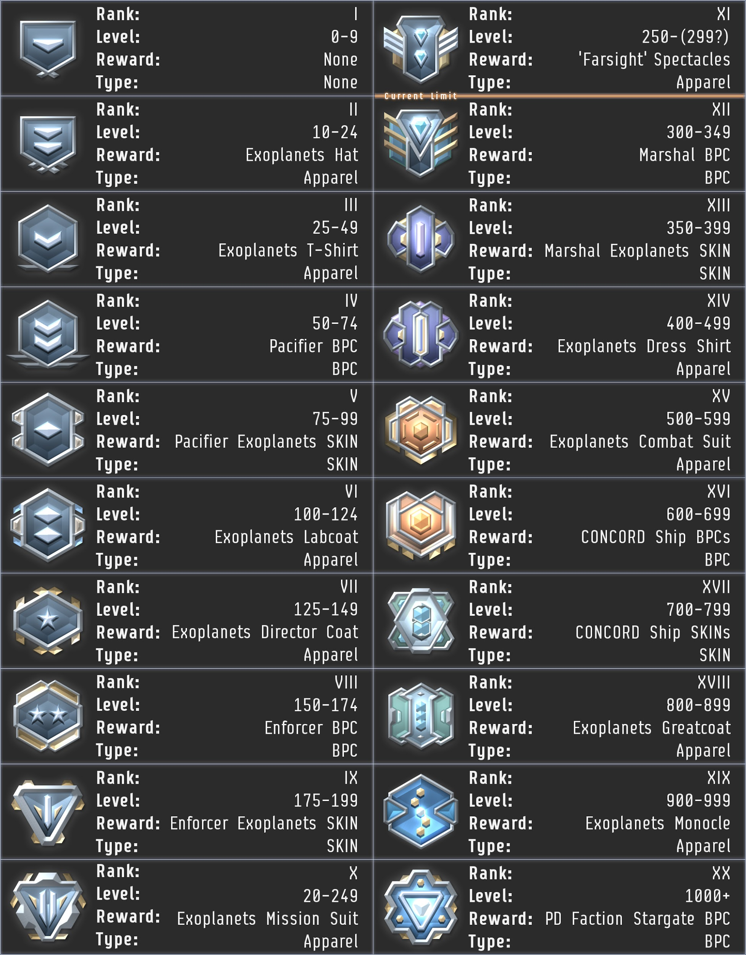
A Perfect 10 - Progression-based Reward System
The unique reward system in Project Discovery created a tiered reward system that awarded the players as they progressed through the expansion.
This is a rare expansion that scored a perfect 10 on our reward scale as it satisfied a combination of all 6 of our scaling criteria in a very unique and fun manner.
As a result, players became more interested in playing through the expansion to unlock each reward as they progress.
The playerbase didn’t seem to care that Project Discovery brought about major changes to certain core mechanics in the game, as they were engrossed by the additional in-game compensation.

Slide 19
Business Implications
Key Takeaways:
The CSM community is likely to be the most angry when CCP makes changes to the core game mechanics.
When players are allowed to provide input, the overall community has a less negative reaction.
However, players don’t always know what’s best, and in those cases CCP must turn to other anger mitigation strategies.
Creating experiences such as Project Discovery in which players constantly receive varied rewards as they progress in the expansion gameplay, can reduce anger.
Notes:
Pratik

Slide 20
Suggestions
Provide more avenues for the community to communicate their opinions on planned changes before they are released to the public.
Make them feel like they contributed and had more control over the changes.
Invest resources in more mini-games and experiences similar to Project Discovery that provide progression based rewards and real world impacts.
Integrate similar reward systems within expansions that change core gameplay mechanics.
Survey players after the release to understand what they liked and dislike and use that knowledge to improve future releases.
Notes:
Pratik

Slide 21
Thank You

